Slide 1

MANAGEMENT OF NATURAL RESOURCES
Management of Natural Resources

Slide 2
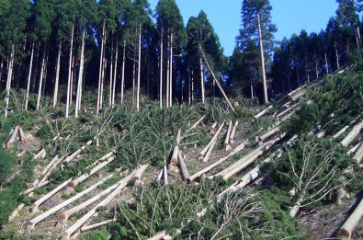



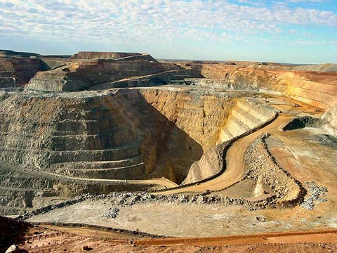
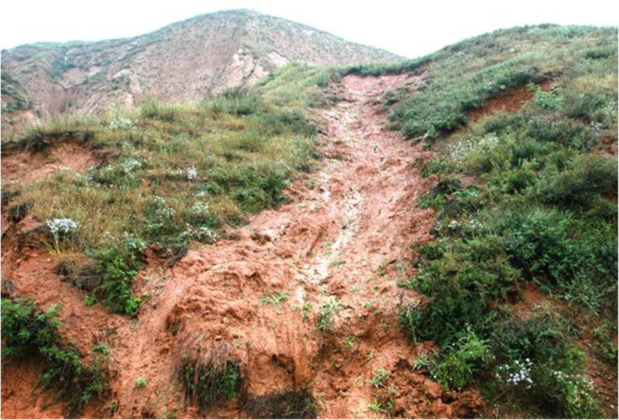
Management of natural resources
for short term gains.
Requires
so that these will last for the generations to come
A long-term perspective
Not mere exploitation to the hilt

Slide 3
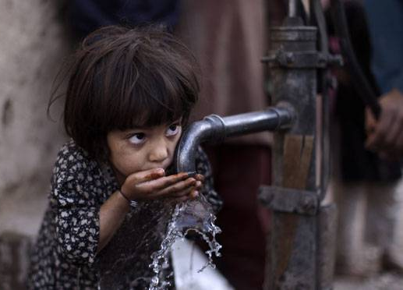

Management of natural resources
So that all, benefit from the development of these resources.
Should
Ensure equitable distribution of resources

Slide 4

Another factor to be considered while we exploit these natural
resources is....

Slide 5
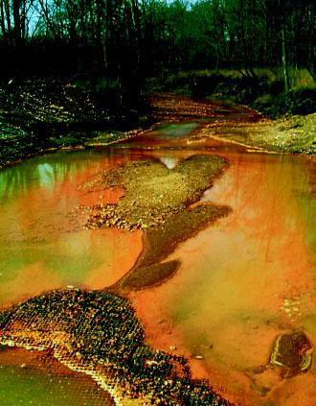
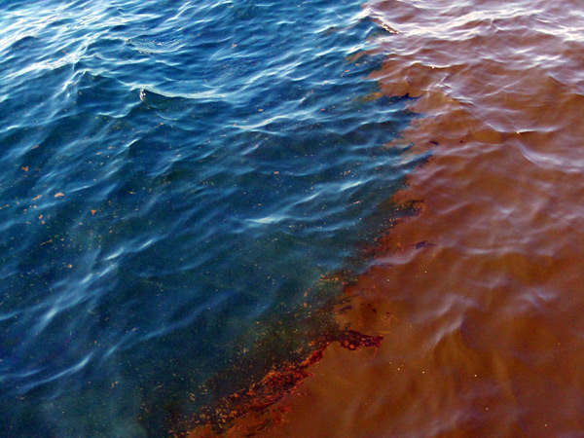
We cause damage to the environment while these resources are either extracted or used.

Slide 6
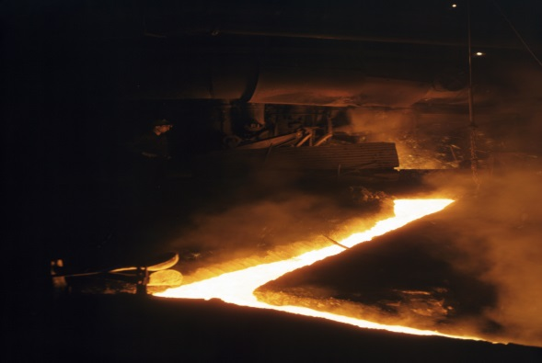
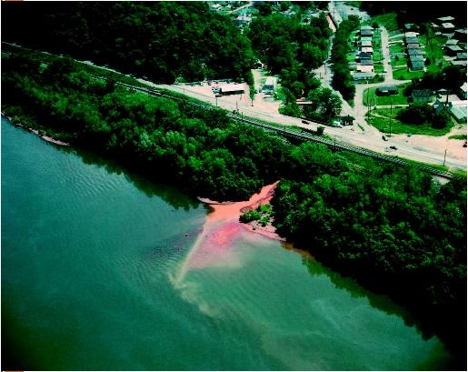
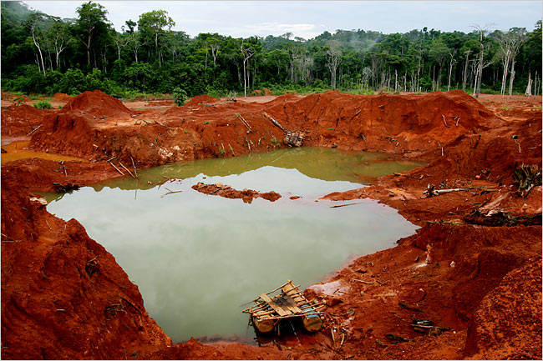
For example, mining causes pollution because of the large amount of slag which is discarded for every tonne of metal extracted.

Slide 7
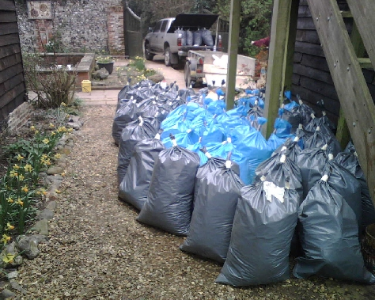
Hence, sustainable natural resource
management demands that we plan for the safe disposal of these
wastes too.

Slide 8
Thank You

